Slide 1

Chapter 14
Database Design

Slide 2
Objectives
Compare and contrast conventional files and modern, relational databases.
Define and give examples of fields, records, files, and databases.
Describe modern data architecture of files, operational databases, data warehouses, personal databases, and work group databases.
Compare roles of systems analyst, database administrator, and data administrator.
Describe architecture of database management system
Describe how a relational database implements entities, attributes, and relationships from a logical data model.
Transform a logical data model into a physical, relational database schema.
Generate SQL to create the database structure in a schema.

Slide 3
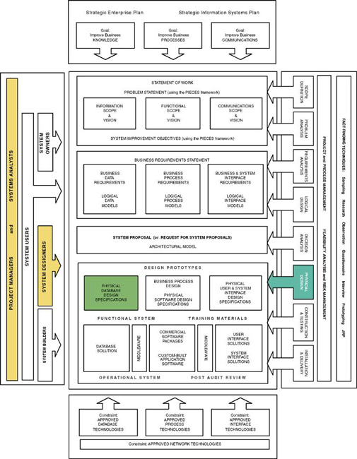

Slide 4
Conventional Files versus the Database
File – a collection of similar records.
Files are unrelated to each other except in the code of an application program.
Data storage is built around the applications that use the files.
Database – a collection of interrelated files
Records in one file (or table) are physically related to records in another file (or table).
Applications are built around the integrated database

Slide 5
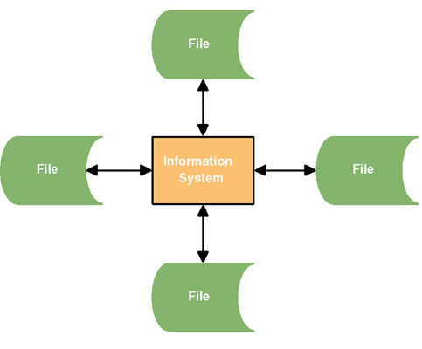
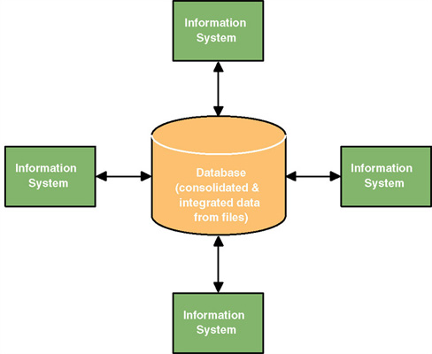
Files versus Database

Slide 6
Pros and Cons of Conventional Files
Pros
Easy to design because of their single-application focus
Excellent performance due to optimized organization for a single application
Cons
Harder to adapt to sharing across applications
Harder to adapt to new requirements
Need to duplicate attributes in several files.

Slide 7
Pros and Cons of Databases
Pros
Data independence from applications increases adaptability and flexibility
Superior scalability
Ability to share data across applications
Less, and controlled redundancy (total non-redundancy is not achievable)
Cons
More complex than file technology
Somewhat slower performance
Investment in DBMS and database experts
Need to adhere to design principles to realize benefits
Increased vulnerability due to consolidating in a centralized database

Slide 8
Fields
Field – the smallest unit of meaningful data to be stored in a database
the physical implementation of a data attribute

Slide 9
Fields (continued)
Primary key – a field that uniquely identifies a record.
Secondary key – a field that identifies a single record or a subset of related records.
Foreign key – a field that points to records in a different file.
Descriptive field – any nonkey field.

Slide 10
Records
Record – a collection of fields arranged in a predetermined format.
Fixed-length record structures
Variable-length record structures
Blocking factor – the number of logical records included in a single read or write operation (from the computer’s perspective).

Slide 11
Files and Tables
File – the set of all occurrences of a given record structure.
Table – the relational database equivalent of a file.

Slide 12
Types of conventional files and tables
Master files – Records relatively permanent though values may change
Transaction files – Records describe business events
Document files – Historical data for review without overhead of regenerating document
Archival files – Master and transaction records that have been deleted
Table lookup files – Relatively static data that can be shared to maintain consistency
Audit files – Special records of updates to other files

Slide 13
File and Table Design
Older file design methods required analyst to specify precisely how records should be:
Sequenced (File organization)
Accessed (File access)
Database technology usually predetermines and/or limits this
Trained database administrator may be given some control over organization, storage location, and access methods for performance tuning.

Slide 14
Data Architecture
Data architecture – a definition of how:
Files and databases are to be developed and used to store data
The file and/or database technology to be used
The administrative structure set up to manage the data resource

Slide 15
Data Architecture (continued)
Data is stored in some combination of:
Conventional files
Operational databases – databases that support day-to-day operations and transactions for an information system. Also called transactional databases.
Data warehouses – databases that store data extracted from operational databases.
To support data mining
Personal databases
Work group databases

Slide 16
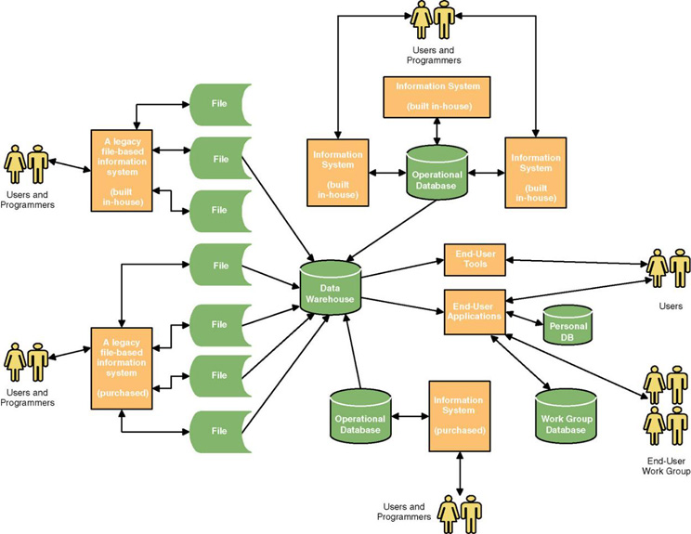
A Modern Data Architecture

Slide 17
Administrators
Data administrator – a database specialist responsible for data planning, definition, architecture, and management.
Database administrator – a specialist responsible for database technology, database design,construction, security, backup and recovery, and performance tuning.
A database administrator will administer one or more databases

Slide 18
Database Architecture
Database architecture – the database technology used to support data architecture
Including the database engine, database utilities, CASE tools, and database development tools.
Database management system (DBMS) – special software used to create, access, control, and manage a database.
The core of the DBMS is its database engine.
A data definition language (DDL) is used to physically define tables, fields, and structural relationships.
A data manipulation language (DML) is used to create, read, update, and delete records in database and navigate between records.

Slide 19
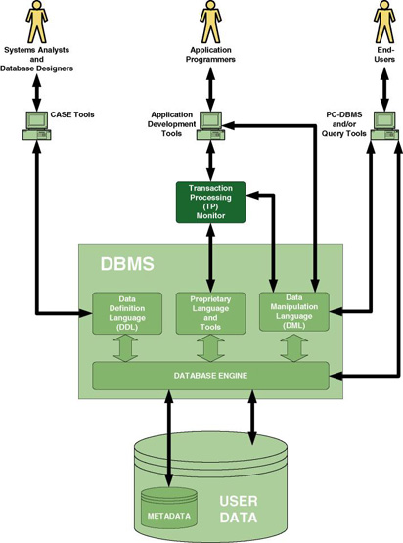
Typical DBMS Architecture

Slide 20
Relational Databases
Relational database – a database that implements stored data in a series of two-dimensional tables that are “related” to one another via foreign keys.
The physical data model is called a schema.
The DDL and DML for a relational database is called SQL (Structured Query Language).
Triggers – programs embedded within a database that are automatically invoked by updates.
Stored procedures – programs embedded within a database that can be called from an application program.

Slide 21
From Logical Data Model …

Slide 22
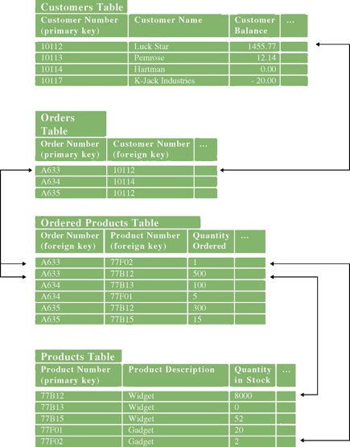
… To Physical Data Model (Relational Schema)

Slide 23
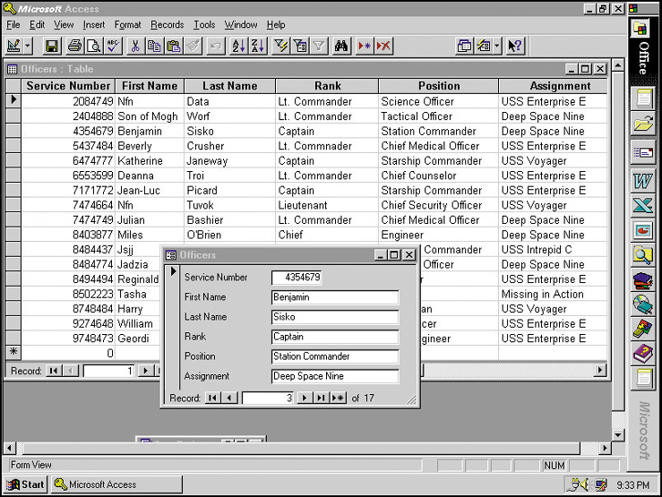
User Interface for a Relational PC DBMS

Slide 24
What is a Good Data Model?
A good data model is simple
The data attributes that describe an entity should describe only that entity
A good data model is essentially nonredundant
Each data attribute exists in at most one entity (except for foreign keys)
A good data model should be flexible and adaptable to future needs
These goals are achieved through database normalization.

Slide 25
Database Normalization (also see Chapter 8)
A logical entity (or physical table) is in first normal form if there are no attributes (fields) that can have more than one value for a single instance (record).
A logical entity (or physical table) is in second normal form if it is in first normal form and if the values of all nonprimary key attributes are dependent on the full primary key.
A logical entity (or physical table) is in third normal form if it is in second normal form and if the values of all nonprimary key attributes are not dependent on other nonprimary key attributes.

Slide 26
Conventional File Design
Output and input designs typically completed first
Fundamental entities from data model designed as master or transaction records
Master files are typically fixed-length records
Associative entities from data model are joined into transaction records as variable-length records
File access and organization selected
Sequential
Indexed
Hashed
ISAM/VSAM

Slide 27
Goals of Database Design
A database should provide for efficient storage, update, and retrieval of data.
A database should be reliable—the stored data should have high integrity and promote user trust in that data.
A database should be adaptable and scalable to new and unforeseen requirements and applications.
A database should support the business requirements of the information system.

Slide 28
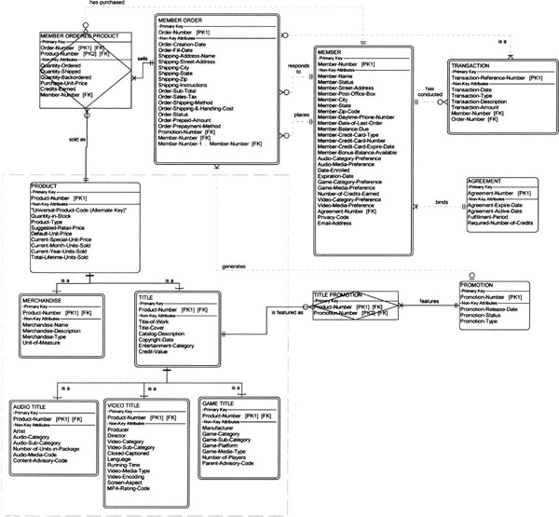
Logical data Model in Third Normal Form

Slide 29
Database Schema
Database schema – a model or blueprint representing the technical implementation of the database.
Also called a physical data model

Slide 30
A Method for Database Design
Review the logical data model.
Create a table for each entity.
Create fields for each attribute.
Create index for each primary & secondary key.
Create index for each subsetting criterion.
Designate foreign keys for relationships.
Define data types, sizes, null settings, domains, and defaults for each attribute.
Create or combine tables to implement supertype/subtype structures.
Evaluate/specify referential integrity constraints.

Slide 31
Database Integrity
Key integrity – Every table should have a primary key.
Domain integrity – Appropriate controls must be designed to ensure that no field takes on an inappropriate value
Referential integrity – the assurance that a foreign key value in one table has a matching primary key value in the related table.
No restriction
Delete: cascade
Delete: restrict
Delete: set null

Slide 32
Data Types for Different Database Technologies
Logical Data Type to be stored in field) | Physical Data Type MS Access | Physical Data Type MS SQL Server | Physical Data Type Oracle
Fixed length character data (use for fields with relatively fixed length character data) | TEXT | CHAR (size) or character (size) | CHAR (size)
Variable length character data (use for fields that require character data but for which size varies greatly--such as ADDRESS) | TEXT | VARCHAR (max size) or character varying (max size) | VARCHAR (max size)
Very long character data (use for long descriptions and notes--usually no more than one such field per record) | MEMO | TEXT | LONG VARCHAR or LONG VARCHAR2

Slide 33
Data Types for Different Database Technologies (cont.)
Logical Data Type to be stored in field) | Physical Data Type MS Access | Physical Data Type MS SQL Server | Physical Data Type Oracle
Integer number | NUMBER | INT (size) or integer or smallinteger or tinuinteger | INTEGER (size) or NUMBER (size)
Decimal number | NUMBER | DECIMAL (size, decimal places) or NUMERIC (size, decimal places) | DECIMAL (size, decimal places) or NUMERIC (size, decimal places) or NUMBER
Financial Number | CURRENCY | MONEY | see decimal number
Date (with time) | DATE/TIME | DATETIME or SMALLDATETIME Depending on precision needed | DATE
Current time (use to store the data and time from the computer’s system clock) | not supported | TIMESTAMP | not supported

Slide 34
Data Types for Different Database Technologies (cont.)
Logical Data Type to be stored in field) | Physical Data Type MS Access | Physical Data Type MS SQL Server | Physical Data Type Oracle
Yes or No; or True or False | YES/NO | BIT | use CHAR(1) and set a yes or no domain
Image | OLE OBJECT | IMAGE | LONGRAW
Hyperlink | HYPERLINK | VARBINARY | RAW
Can designer define new data types? | NO | YES | YES

Slide 35
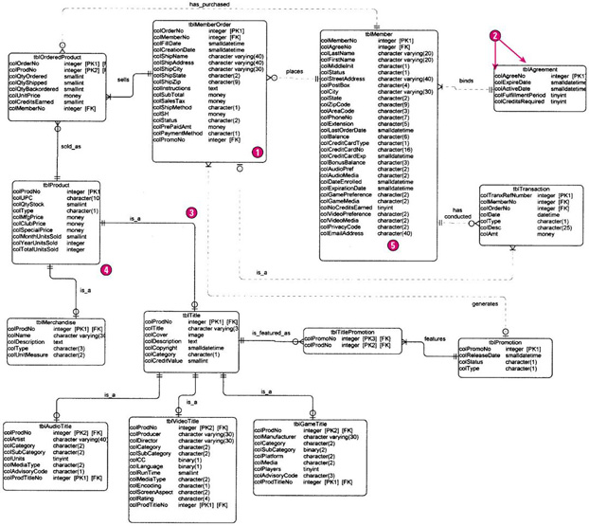
Physical Database Schema

Slide 36
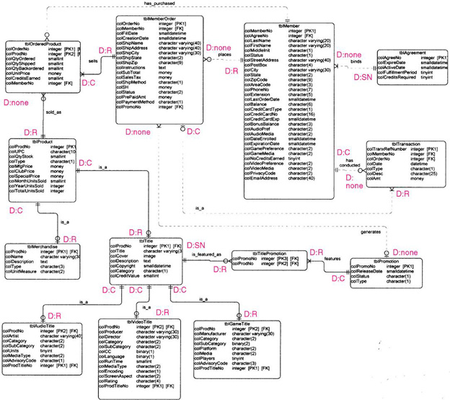
Database Schema with Referential Integrity Constraints

Slide 37
Database Distribution and Replication
Data distribution analysis establishes which business locations need access to which logical data entities and attributes.

Slide 38
Database Distribution and Replication (continued)
Centralization
Entire database on a single server in one physical location
Horizontal distribution (also called partitioning)
Tables or row assigned to different database servers/locations.
Efficient access and security
Cannot always be easily recombined for management analysis
Vertical distribution (also called partitioning)
Specific table columns assigned to specific databases/servers
Similar advantages and disadvantages of Horizontal
Replication
Data duplicated in multiple locations
DBMS coordinates updates and synchronization
Performance and accessibility advantages
Increases complexity

Slide 39
Database Capacity Planning
For each table sum the field sizes. This is the record size.
For each table, multiply the record size times the number of entity instances to be included in the table (planning for growth). This is the table size.
Sum the table sizes. This is the database size.
Optionally, add a slack capacity buffer (e.g. 10percent) to account for unanticipated factors. This is the anticipated database capacity.

